Slide 1
Q355/Q590 Today: Single neuron models and neurophysiology of learning

Slide 2
Slide 1

Slide 3
Mathematical models of action potential
Slide 2
Hodgkin & Huxley model
Izhikevich model
Integrate & fire model
Rate coded model

Slide 4
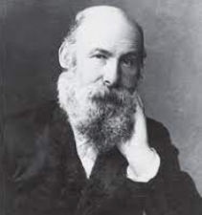
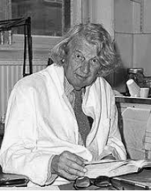
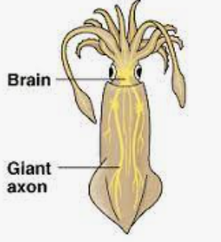
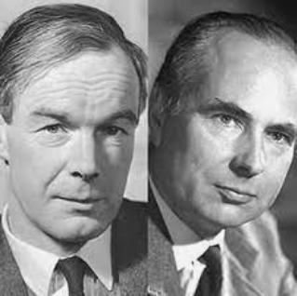
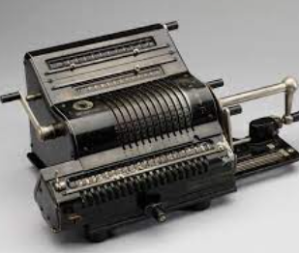
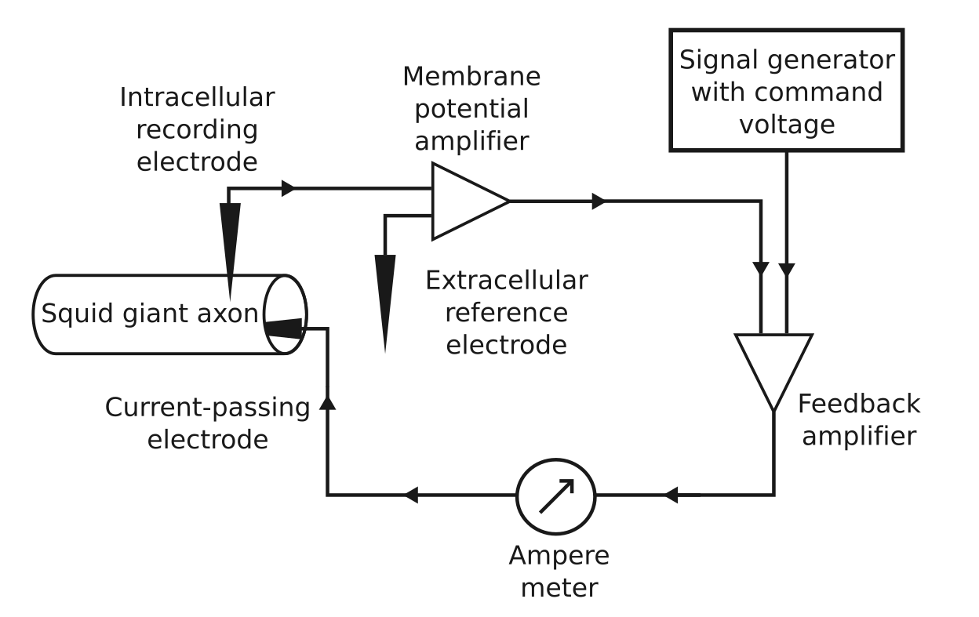
Slide 3
Hodgkin - Huxley and the discovery of neurophysiological events of an action potential
Julius Bernstein – Ionic theory of action potential generation (1902)
John Zachary Young – Discovery of the giant squid axon (1936)
Alan Hodgkin (left) and Andrew Huxley (right) – Hodgkin & Huxley model of action potential generation (1952)
Voltage clamp technique
Brunsviga calculating machine
Notes:
Ionic theory of action potentials: Hypothesis given by Julius Bernstein in 1902– he called it the ionic theory of action potential generation – he said that there have to be ionic gradients across the membrane , this cell membrane somehow breaks down to allow the ions to flow down the gradients
No way to experimentally to validate or falsify the theory at that time - neurons are so small. The thickness of largest neurons in our body is about the same as the thickness of one hair (~ 100 microns).
1936. John Zachary Young – was working on North-Atlantic long-finned squid - observed that there are long transparent structures- neural ganglia and could conduct action potentials. These squid axons were about 1000 times thicker in diameter.
Hodgkin & Huxley – Squid axon, a technique called voltage clamp, they looked at the ionic currents at various set voltages and the events accompanying an action potential.
They used this Brunsviga calculating machine to estimate the parameters of their model.

Slide 5

Brunsviga machine

Slide 6
Slide 4
Hodgkin & Huxley model
Conductance based model
Membrane approximated as an RC circuit with resistances (that is, conductances) dependent on the membrane voltage
Every sodium channel has 3 activation gates, and one inactivation gate.
m = probability that its activation gate is open h = probability that its inactivation gate is open
What is the probability that a sodium channel is open? → m³h
Every potassium channel has 4 activation gates.
n = probability that potassium activation gate is open
n⁴ = Probability that a potassium channel is open

Slide 7
Slide 5
Notes:
RC circuit approximation of membrane a little more
The key assumption in this RC circuit approximation is assuming the ionic current to be ohmic at certain V→ that is coming from ohm’s law → proportionality between current and Voltage. This is a good enough approximation.

Slide 8
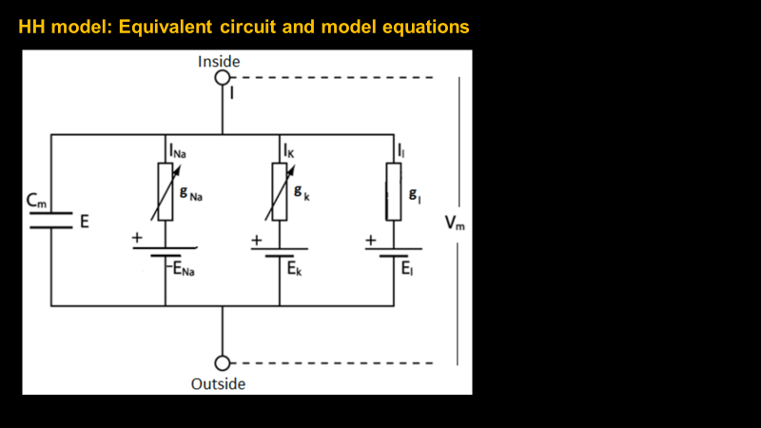
Slide 6
Notes:
Capacitive current; We know that Q = CV → for current we differentiate the Q with time. Capacitive current, I = dQ/dt = CdV/dt

Slide 9
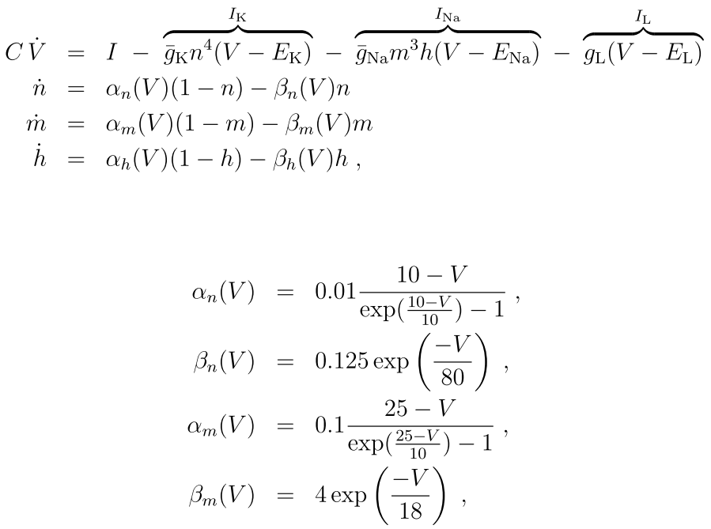

Slide 7
V: Membrane potential
E_{x}: Nernst potential of ion X
g_{x}: Maximum conductance of ion X (Conductance when all channels of X are open)
m, h: probability that the activation and inactivation gates are open in a sodium channel, respectively
g_{Na}*m³h = Average sodium conductance at some values m and h (that is, at a given V)
n: probability that activation gate of a potassium channel in open
g_{K}*n⁴ = Average potassium conductance at a given value of n (that is, at a given V)
Notes:
Gating variables are dependent on membrane potential

Slide 10
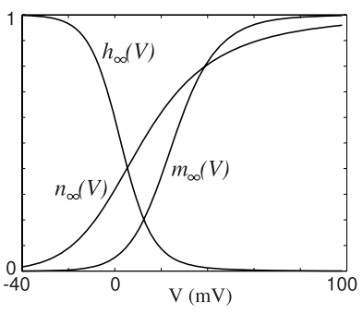
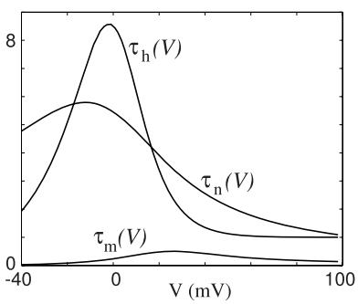


Slide 8
HH model: Gating variables kinetics
Steady state values of gating variables, m, h, and n
Time constants of gating variables, m, h, and n
(Larger value → slower dynamics)
Notes:
Kinetics of gating variable.
N infinity: If membrane voltage remains constant at certain value, say through a voltage clamp, then n will eventually become equal to n infinity.

Slide 11
Slide 9
Notes:
Notice that it is not a very useful equation → not a good separation of variables → m,h, and n contain ‘V’ term as well; But when V is near Vrest, the gating variables can be assumed constant → this equation in useful to predict how Vm will change with changes in conductances in this situation.

Slide 12
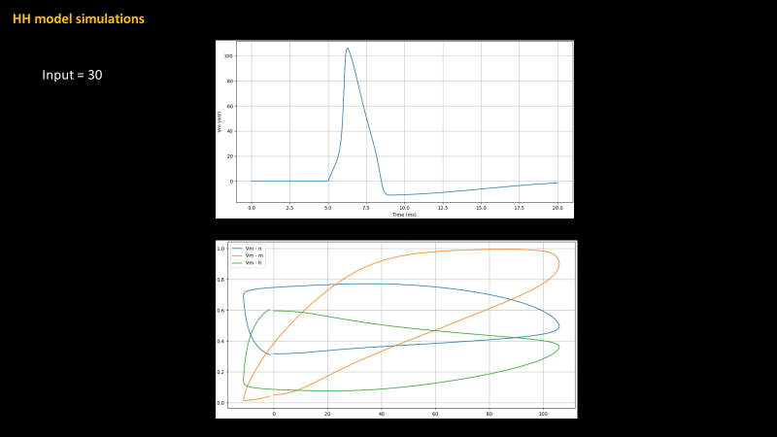
Slide 10
Notes:
Lower plot: x-axis is membrane voltage; y-axis is value of gating variable.

Slide 13
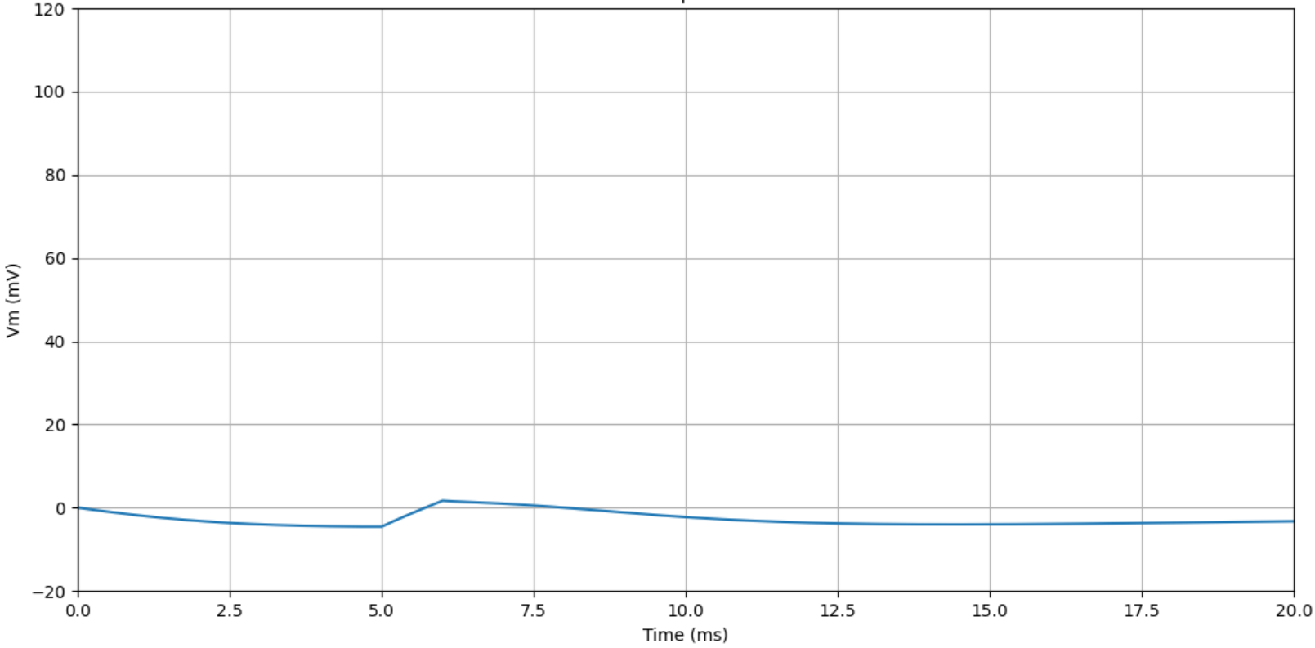
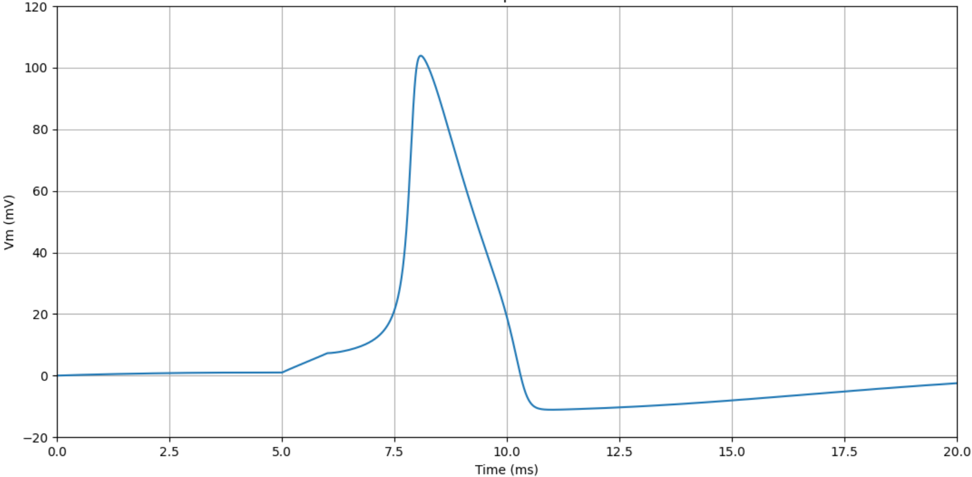
Slide 11
gL decreased to 0.1
(original value = 0.3)
Input = 7
gK was decreased to 32 (Original value = 36)
Input = 7
Notes:
Leak → positive ions coming in; less gL: less positive ions coming in. From that equation on slide 9→ How will Vrest change? Vrest decreases.
Gk decreased → less positive ions (k+) flowing out → Vrest increased a little.

Slide 14
HH model: Drawbacks
Slide 12
Hodgkin-Huxley neurons are computationally expensive
Thus, non-scalable
Towards simple models . . .
How can the HH model be simplified while still retaining spiking dynamics?
Better question:
What are the basic requirements to generate spiking?
The ‘m’ in HH model
Answer: At least,
One fast excitation variable
One slow recovery variable
Izhikevich neuron model
‘h’ and ‘n’ in HH model

Slide 15
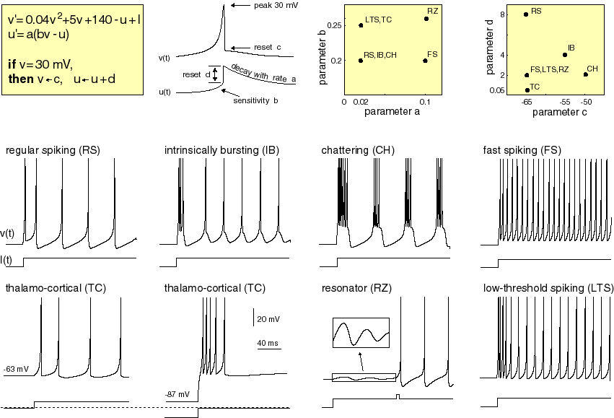
Izhikevich neuron model
Slide 13
Not as biologically detailed
More computationally efficient than Hodgkin-Huxley
2 state variables, plus integrate-and-fire

Slide 16


What if we are only interested to know whether an action potential happened or not? We are not interested in detail on how it came about.
Slide 14
➔ Integrate and Fire Neuron
In that case, we can just see when the neuronal membrane reaches Vthresh; We can consider the neuron to have generated an action potential when the former happens.
Notes:
We know action potential happened or not, based on if V crossed Vthresh.
m,n,h: small changes around the resting potential→ don’t lead to large changes in ionic currents → Safely assume ionic currents to bezero for sub-threshold fluctuations in V.

Slide 17
What if we are not even interested to know whether an action potential happened or not? We only care about frequency of action potential generation.
Slide 15
➔ Rate-coded model

Slide 18
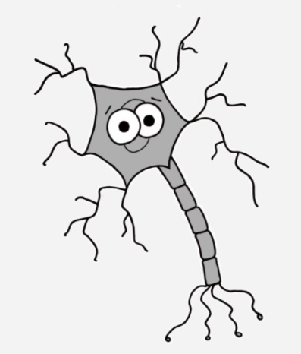
Slide 16
I have some questions!
Q1. Which of the following models has parameters that have direct correspondence with the physiological properties of the neuronal membrane?
Integrate & Fire model
B. Hodgkin and Huxley model
C. Izhikevich model
D. Rate-coded model
Q2. Consider that certain drug affects the excitability of neurons in certain part of brain. I have data on neuron dynamics from single neuron recordings with or without the drug applied to a neuron from this region.
Using a neuron model and modifying the model to add the effect of drug, I want to understand how the drug affects the neuron – Which ionic currents get affected? Does it affect sodium channels or potassium channels? How exactly does it affect the kinetics of channel opening/closing?
Which of the following would be the best choice to model the neuron in this case?
Integrate & Fire model
B. Conductance based model (Hodgkin & Huxley)
C. Izhikevich model
D. Rate-coded model
Notes:
Q1 → B. HH model
Q2. → B. HH model

Slide 19
Slide 17
I have some questions!
Q3. Say, I have a network of neurons connected to each other via excitatory/inhibitory connections.
Under different input conditions, I want to find the pattern of activity at which this network settles.
Which of the following would be the best choice to model the neurons in this case?
Integrate & Fire model
B. Conductance based model (Hodgkin & Huxley)
C. Izhikevich model
D. Rate-coded model
Notes:
Ans. A. Integrate and Fire neuron

Slide 20
Slide 18
I have some questions!
Q4. Consider that you are constructing a multilayered network of visual cortex. The input layer is retinal ganglion neurons – the layer is meant to signal amount of contrast in input images.
Say, you are told that the ganglion neurons have greater frequency of firing to a greater contrast – so the information about the contrast is in the frequency (rate) of firing.
Which of the following would be the best choice to model the neurons in this layer?
Integrate & Fire model
B. Conductance based model (Hodgkin & Huxley)
C. Izhikevich model
D. Rate-coded model
Notes:
Q4. D. rate coded model

Slide 21
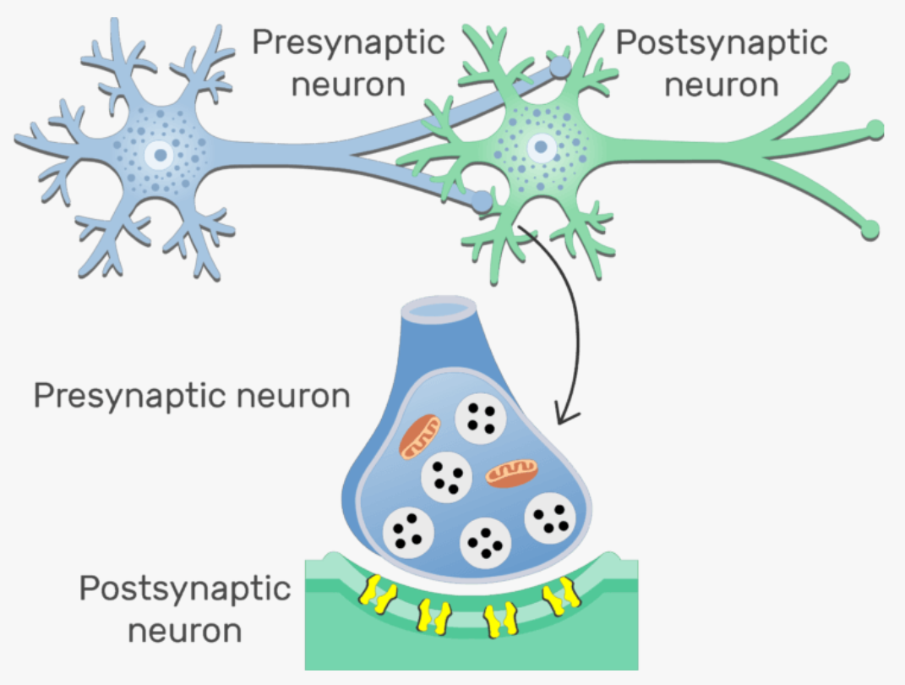
How do neurons communicate?
Slide 19
Synapse: The junction between 2 neurons where the communication happens
What is the nature of the signal between one neuron and the other?
Chemical
Electrical
C. Physical
mostly
Notes:
Some rare cases of electrical transmission through gap junctions – electrical neurotransmission.

Slide 22
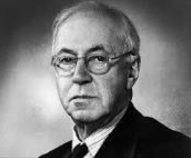
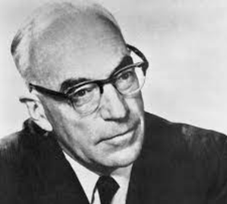
Slide 20
Synaptic transmission: Soup vs spark debate – 1930s
Sir Henry Hallett Dale (1875 – 1968)
Sir John Carew Eccles (1903 – 1997)
Proponent of chemical neurotransmission
Proponent of electrical neurotransmission
Notes:
2 opposing theories about how neurotransmission happens in brain – the people that you see on the slide were the two main proponents of these opposing theories. Experimental techniques at the time were not adequate in experimentally determining the nature of neuronal communication.
John Eccles proved chemical neurotransmission 20 years later – ironic!

Slide 23
Slide 21
John Eccles experiment with cat motoneurons
It was known that A (hamstring sensory neuron) inhibited B (quadriceps motoneuron)
Two hypotheses: When A is stimulated (so that the axonal terminal depolarizes) -
1. H1: Electrical neuronal transmission happens from A to B; → Increase in PSP indicates H1 is true
(inhibitory effect of A on B is brought about by some downstream mechanisms )
2. H2: Chemical neurotransmission happens from A to B → Decrease in PSP indicates H2 is true
(Chemical neurotransmission can do inhibition directly – no downstream mechanisms required)
Decrease in PSP observed → chemical neurotransmission
Neurons also need to have some chemistry in order to understand each other’s feelings fillings!
Notes:
For this discovery, John Eccles received noble prize in physiology in 1963 along with Hodgkin and Huxley

Slide 24
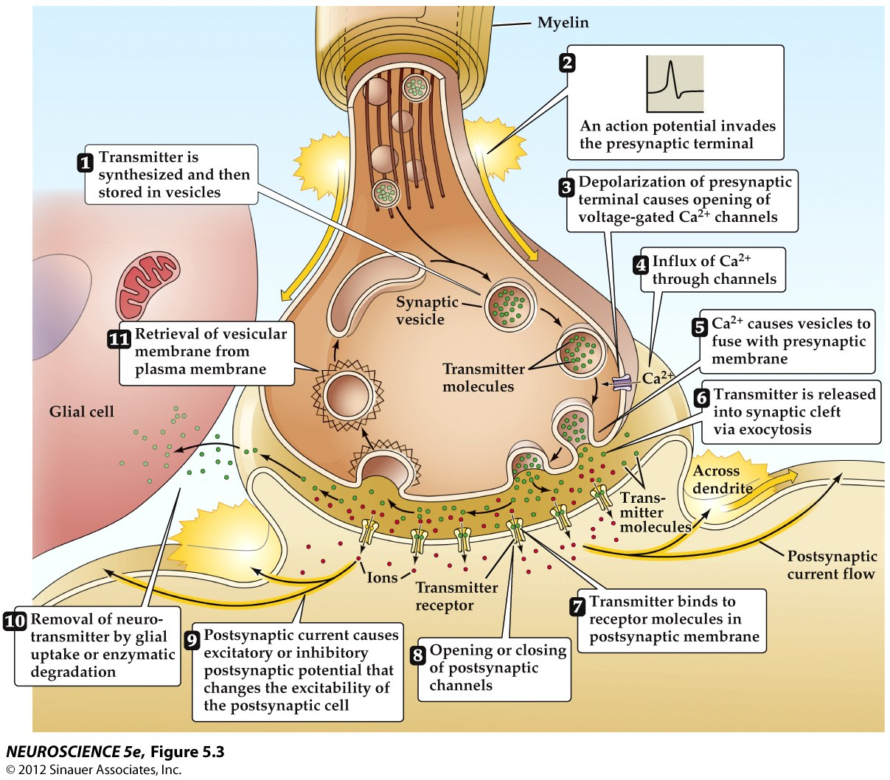
So, what exactly happens at the synapse?
Slide 22
Notes:
Whether a pre-synaptic neuron gets inhibited or excited depends on what neurotransmitter was released by the pre-synaptic neuron and the receptors on post-synaptic neuron to which the neurotransmitter binds.

Slide 25
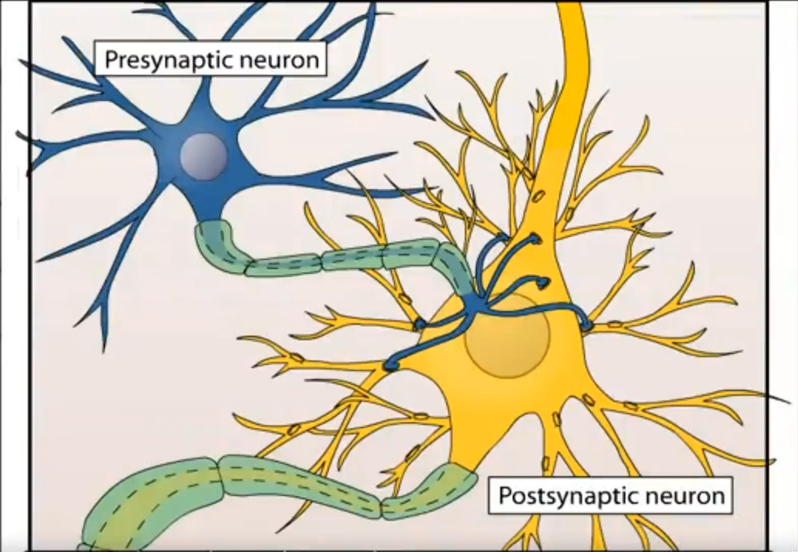
Transmitter release - animation
Slide 23

Slide 26
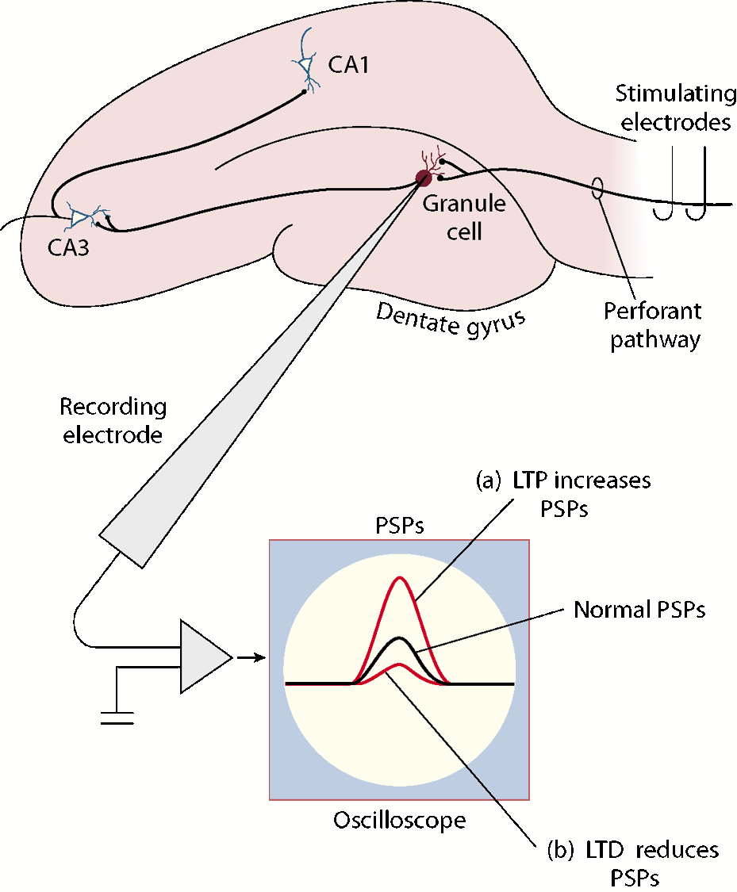
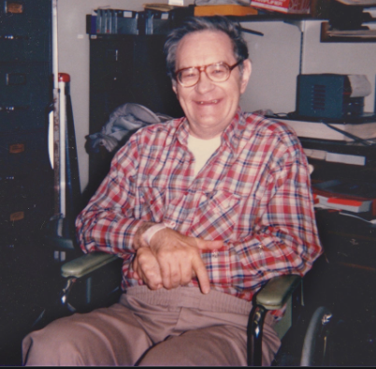
Synaptic plasticity
Slide 24
Patient H.M.
Underwent surgical removal of parts of middle temporal lobe including hippocampus to treat epilepsy – suffered from anterograde amnesia as a result.
LTP discovered in Rabbit hippocampus by Terje Lømo in 1966
Notes:
Patient H.M – his case generated interest in hippocampus as a region of investigation for memory. In one of the first such experiments -
LTP: EC to Dentate gyrus
One type of LTP observed in hippocampus in NMDA dependent LTP.

Slide 27
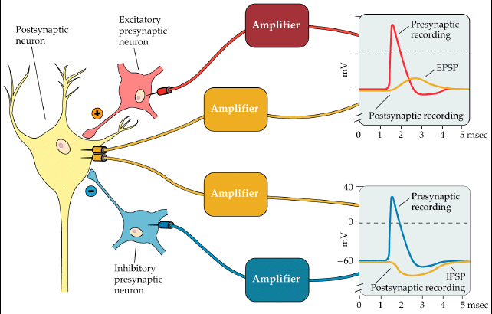
Excitation vs. Inhibition
Slide 25
EPSP – excitatory post-synaptic potential
IPSP – inhibitory post-synaptic potential
Long-term potentiation: Increased EPSP of post-synaptic neuron after repeated excitation of the pre-synaptic neuron.

Slide 28
Two of the theoretical models of synaptic plasticity
Slide 26

Slide 29
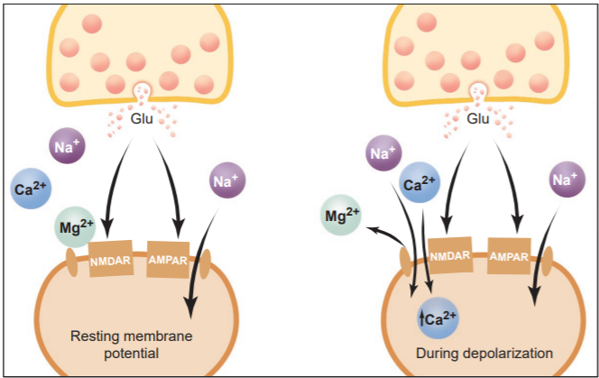
Slide 27
NMDA mediated LTP in hippocampus
Notes:
Glutamate release from pre-syn → Binds to AMPA and NMDA receptors →this opens both the receptors →NMDA is permeable to calcium ions; however, magnesium ions block it, and so calcium ions cannot flow in, unless – Post-synaptic neuron is depolarized → magnesium ions pushed out → calcium ions flow into it.
The Ca²⁺ that enters the cell triggers the upregulation of AMPARs to the membrane, which results in a long-lasting increase in EPSP size underlying LTP.

Slide 30
I have some questions!
Slide 28
Q1. When the neurotransmitter GABA binds to the GABA receptors on post-synaptic neuron membrane, it allows the flow of chloride ions across the membrane. What is the effect of GABA on post-synaptic neuron?
A. Excitatory B. Inhibitory
Q2. Which among the following is a ‘coincidence detector’ in one type of LTP in hippocampus that we discussed in this class?
AMPA receptors
Calcium ions
NMDA receptors
Magnesium ions
Q3. Cocaine inhibits the reuptake of dopamine by blocking dopamine transporter proteins. What does this do to the dopamine concentration in synaptic cleft?
A. It gets high B. Stays the same C. It decreases
Notes:
Answers:
Q1. B – Inhibitory
Q2. C – NMDA receptors
Q3. A – Gets high

Slide 31

Adios neurophysiology …
(for now)
Neuron song by students at American University
Performed by Jason Sager (http://jasonsager.net)
Lyrics by Jason Sager and David Jangraw

